Slide 1
Hofstadter’s butterfly
Dongsin Kim
Department of Physics, Sogang University, Seoul, Korea
2025/12/12

Slide 2
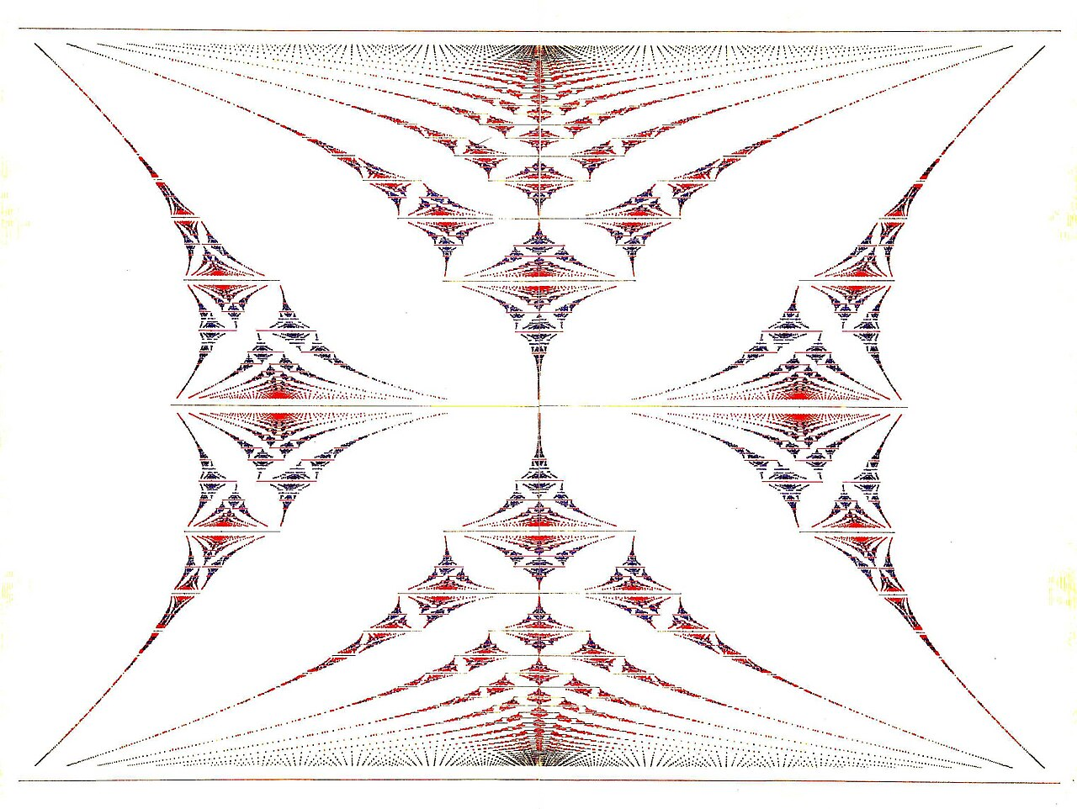
Hofstadter’s butterfly
Hofstadter’s butterfly is a graph of the spectral properties of non-interacting two-dimensional electrons in a perpendicular magnetic field in a lattice.
Figure from Wikipedia: https://en.wikipedia.org/wiki/Hofstadter%27s_butterfly

Slide 3
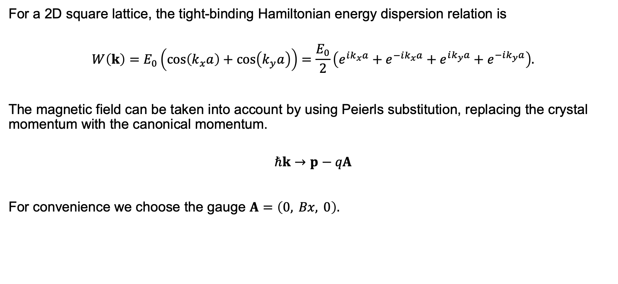
Theoretical model
For a 2D square lattice, the tight-binding Hamiltonian energy dispersion relation is
$$W\left(k\right)=E_{0}\left(cos\left(k_{x}a\right)+cos\left(k_{y}a\right)\right)=\frac{E_{0}}{2}\left(e^{ik_{x}a}+e^{−ik_{x}a}+e^{ik_{y}a}+e^{−ik_{y}a}\right).$$
The magnetic field can be taken into account by using Peierls substitution, replacing the crystal momentum with the canonical momentum.
$$ℏk→p−qA$$
For convenience we choose the gauge $A=\left(0, Bx, 0\right).$
Hofstadter, Douglas R., Physical Review B. 14 2239-2249, (1976)

Slide 4
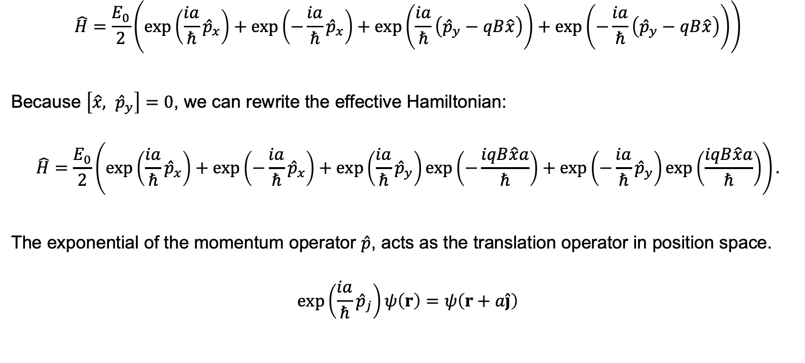
Theoretical model
$$\hat{H}=\frac{E_{0}}{2}\left(exp\left(\frac{ia}{ℏ}{\hat{p}}_{x}\right)+exp\left(−\frac{ia}{ℏ}{\hat{p}}_{x}\right)+exp\left(\frac{ia}{ℏ}\left({\hat{p}}_{y}−qB\hat{x}\right)\right)+exp\left(−\frac{ia}{ℏ}\left({\hat{p}}_{y}−qB\hat{x}\right)\right)\right)$$
Because $\left[\hat{x}, {\hat{p}}_{y}\right]=0$, we can rewrite the effective Hamiltonian:
$$\hat{H}=\frac{E_{0}}{2}\left(exp\left(\frac{ia}{ℏ}{\hat{p}}_{x}\right)+exp\left(−\frac{ia}{ℏ}{\hat{p}}_{x}\right)+exp\left(\frac{ia}{ℏ}{\hat{p}}_{y}\right)exp\left(−\frac{iqB\hat{x}a}{ℏ}\right)+exp\left(−\frac{ia}{ℏ}{\hat{p}}_{y}\right)exp\left(\frac{iqB\hat{x}a}{ℏ}\right)\right).$$
The exponential of the momentum operator $\hat{p}$, acts as the translation operator in position space.
$$exp\left(\frac{ia}{ℏ}{\hat{p}}_{j}\right)ψ\left(r\right)=ψ\left(r+a\hat{j}\right)$$
Hofstadter, Douglas R., Physical Review B. 14 2239-2249, (1976)

Slide 5
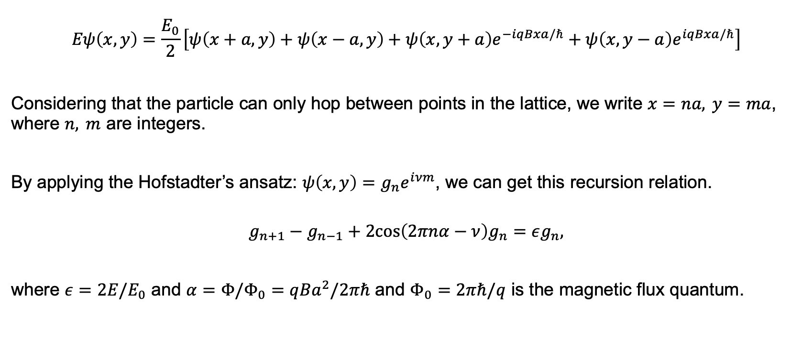
Theoretical model
$$Eψ\left(x,y\right)=\frac{E_{0}}{2}\left[ψ\left(x+a,y\right)+ψ\left(x−a,y\right)+ψ\left(x,y+a\right)e^{−iqBxa/ℏ}+ψ\left(x,y−a\right)e^{iqBxa/ℏ}\right]$$
Considering that the particle can only hop between points in the lattice, we write $x=na, y=ma$, where $n, m$ are integers.
By applying the Hofstadter’s ansatz: $ψ\left(x,y\right)=g_{n}e^{iνm}$, we can get this recursion relation.
$$g_{n+1}−g_{n−1}+2cos\left(2πnα−ν\right)g_{n}=εg_{n},$$
where $ε=2E/E_{0}$ and $α=Φ/Φ_{0}=qBa^{2}/2πℏ$ and $Φ_{0}=2πℏ/q$ is the magnetic flux quantum.
Hofstadter, Douglas R., Physical Review B. 14 2239-2249, (1976)

Slide 6
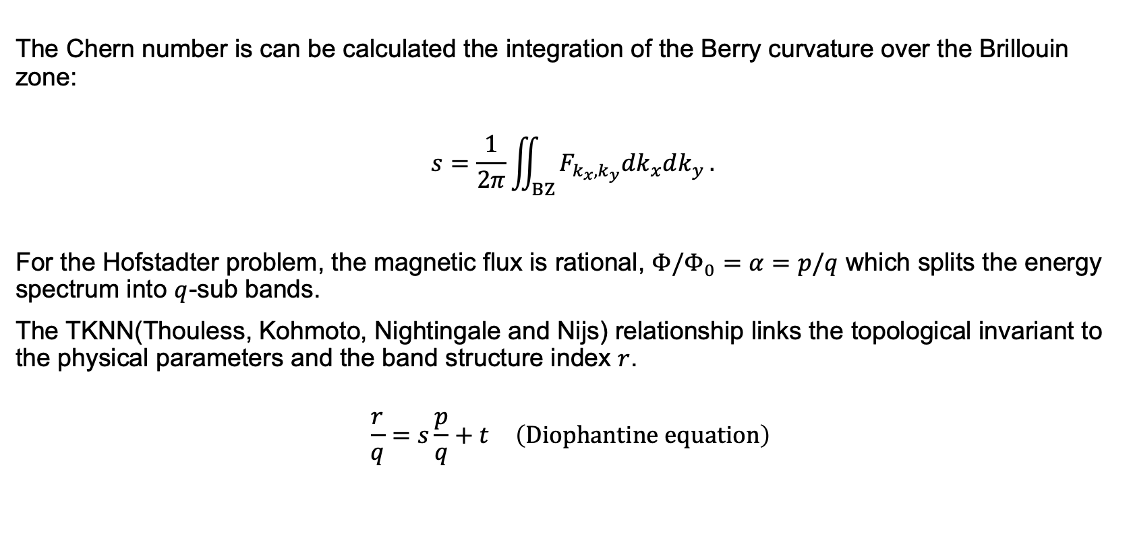
Theoretical model
The Chern number is can be calculated the integration of the Berry curvature over the Brillouin zone:
$$s=\frac{1}{2π}\iint_{BZ}^{0}{F_{k_{x},k_{y}}dk_{x}dk_{y}}.$$
For the Hofstadter problem, the magnetic flux is rational, $Φ/Φ_{0}=α=p/q$ which splits the energy spectrum into $q$-sub bands.
The TKNN(Thouless, Kohmoto, Nightingale and Nijs) relationship links the topological invariant to the physical parameters and the band structure index $r$.
$$\frac{r}{q}=s\frac{p}{q}+t \left(Diophantine equation\right)$$
Thouless D et al., Physical Review Letters. 49 405-408, (1982)

Slide 7
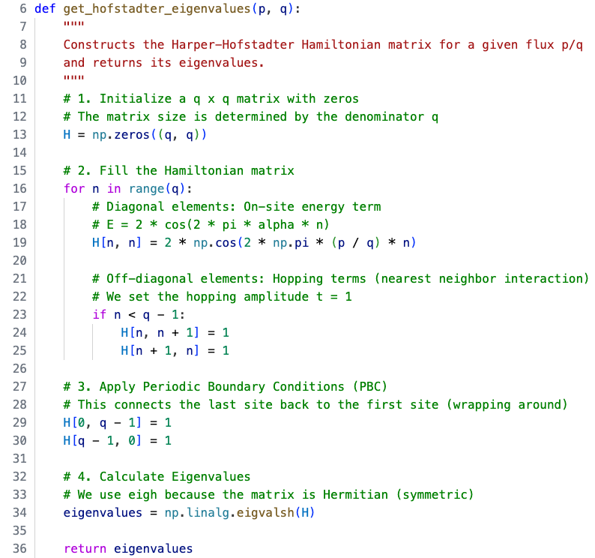
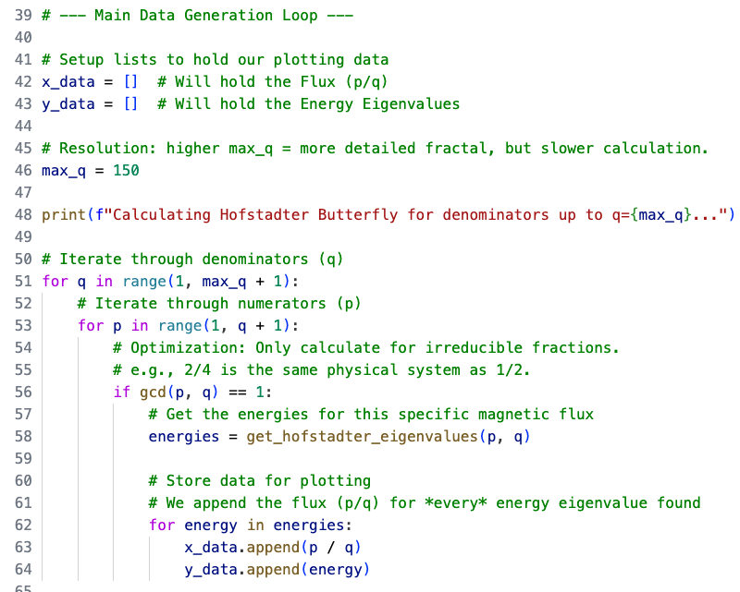
Code implementation

Slide 8
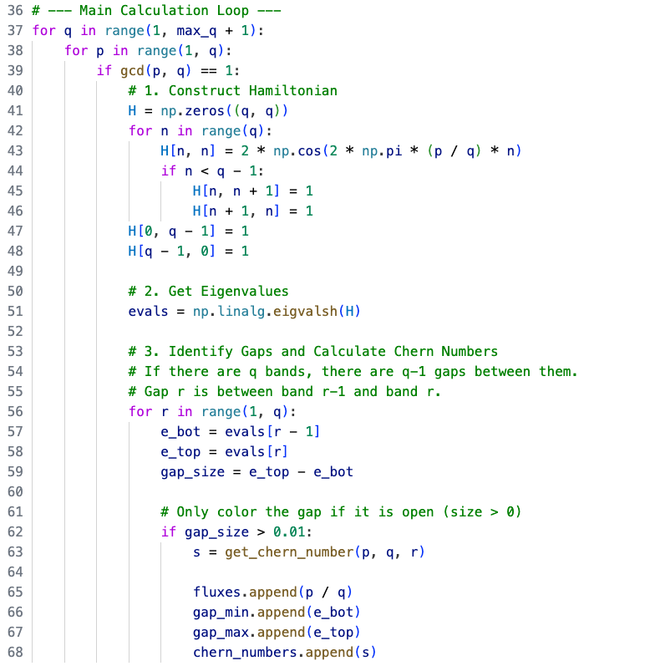
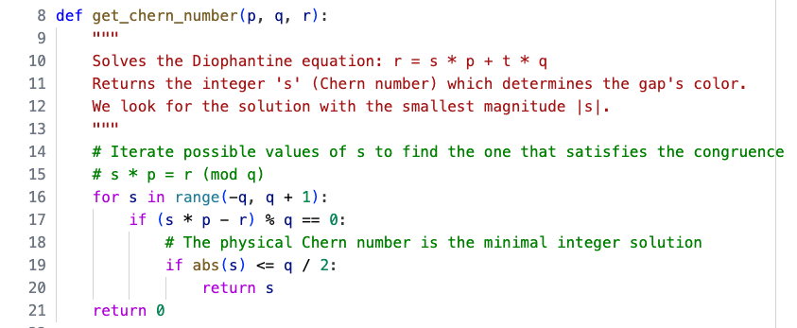
Code implementation

Slide 9
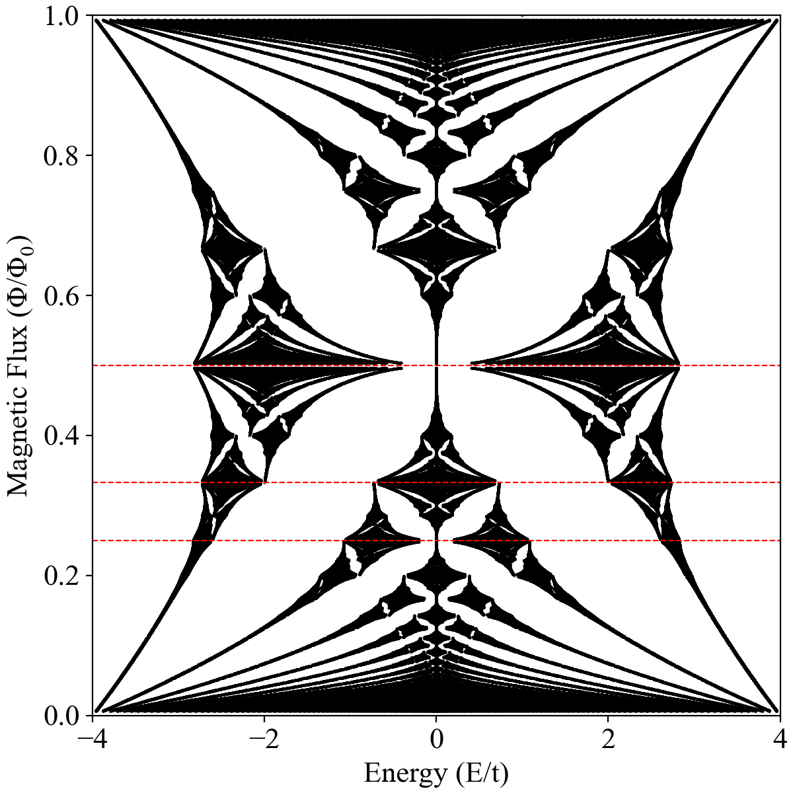
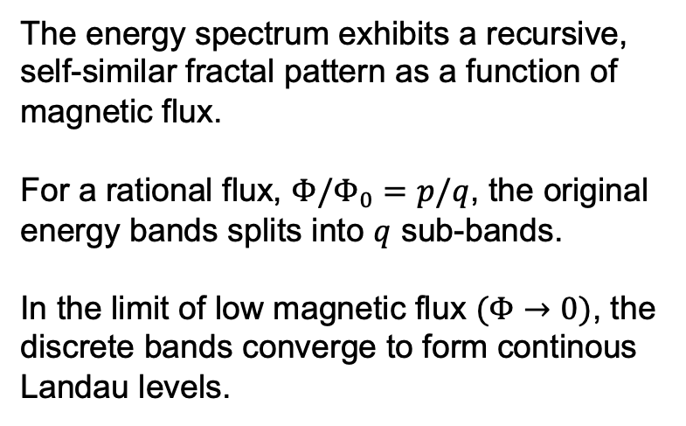
Results
Hofstadter’s butterfly
The energy spectrum exhibits a recursive, self-similar fractal pattern as a function of magnetic flux.
For a rational flux, $Φ/Φ_{0}=p/q$, the original energy bands splits into $q$ sub-bands.
In the limit of low magnetic flux $(Φ→0)$, the discrete bands converge to form continous Landau levels.

Slide 10
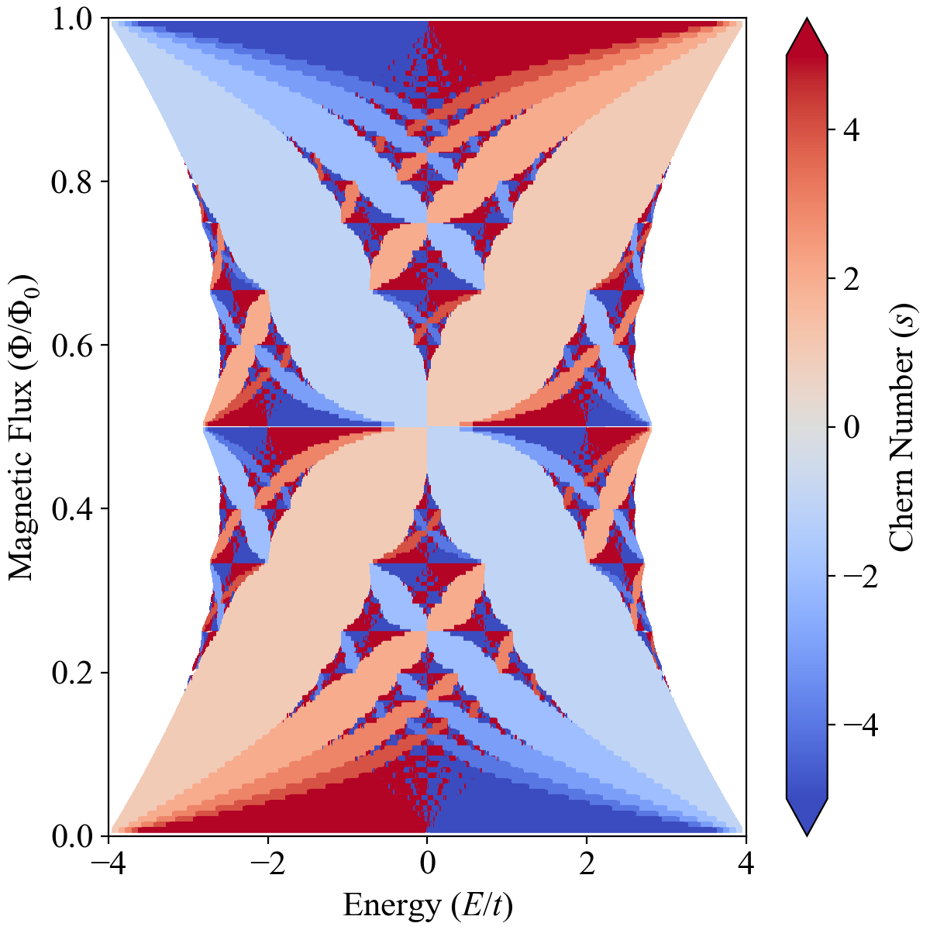
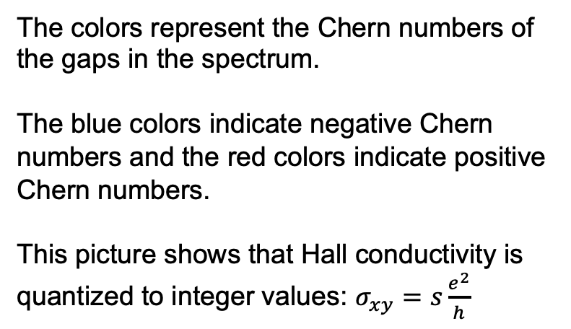
Results
Chern nubmer (TKNN number)
The colors represent the Chern numbers of the gaps in the spectrum.
The blue colors indicate negative Chern numbers and the red colors indicate positive Chern numbers.
This picture shows that Hall conductivity is quantized to integer values: $σ_{xy}=s\frac{e^{2}}{h}$

Slide 11
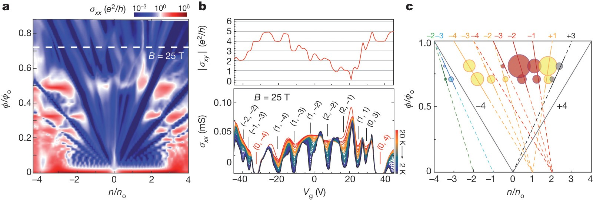
Future works
Hofstadter’s butterfly in graphene
Dean, C.R. et al., Nature 497 598-602, (2013)

